Slide 1
Building Modern Data Warehouse
Sashank Pappu
Azure Data & AI Specialist

Slide 2


Sashank Pappu
Azure Data & AI Specialist.
Certified from MIT on ‘Advanced Analytics and Big Data Challenges’. Technology Enthusiast and Data Specialist. Certified Designer in Computer Vision
• Microsoft Certified Azure Data Architect. • Microsoft Certified Azure Machine Learning Developer • Certified on Practical Data Analytics with Microsoft Cortana Intelligence Suite.
9+ years of total experience as Data Specialist and Data Engineer.
Certifications
Experience
Currently working as Independent Consultant on Azure Data & AI and Enterprise Trainer on Azure Data Analytics , Cortana Intelligence Suite and Cognitive Sciences
Expert facilitator and corporate behavioral trainer with 5 years of experience in designing programs, content development , Data Analytics and Machine Learning.
Role
Training
Sri Nag Sashank
You can see me on – Sashankpappu.com

Slide 3




The session will span for 5 days & it is mandatory to attend all the days.
Self-Paced labs have been developed & access will be shared during the session.
The audience can participate in the leaning. However, it DOES NOT come with “Azure Subscriptions” & request users to arrange on their own.
A proctor will be available to take your queries via “Chat” window. Kindly “MUTE” and do not disturb the presenter.
The sessions are recorded. Will be made available through LMS at the end of series.
Note: More trainings on the same & similar topics would be delivered in near future. Keep your options open.
Guidelines for the event

Slide 4

I tried to understand the modern data warehouse on my own…
And felt like I was body slammed by Randy Savage:
Let’s prevent that from happening…

Slide 5
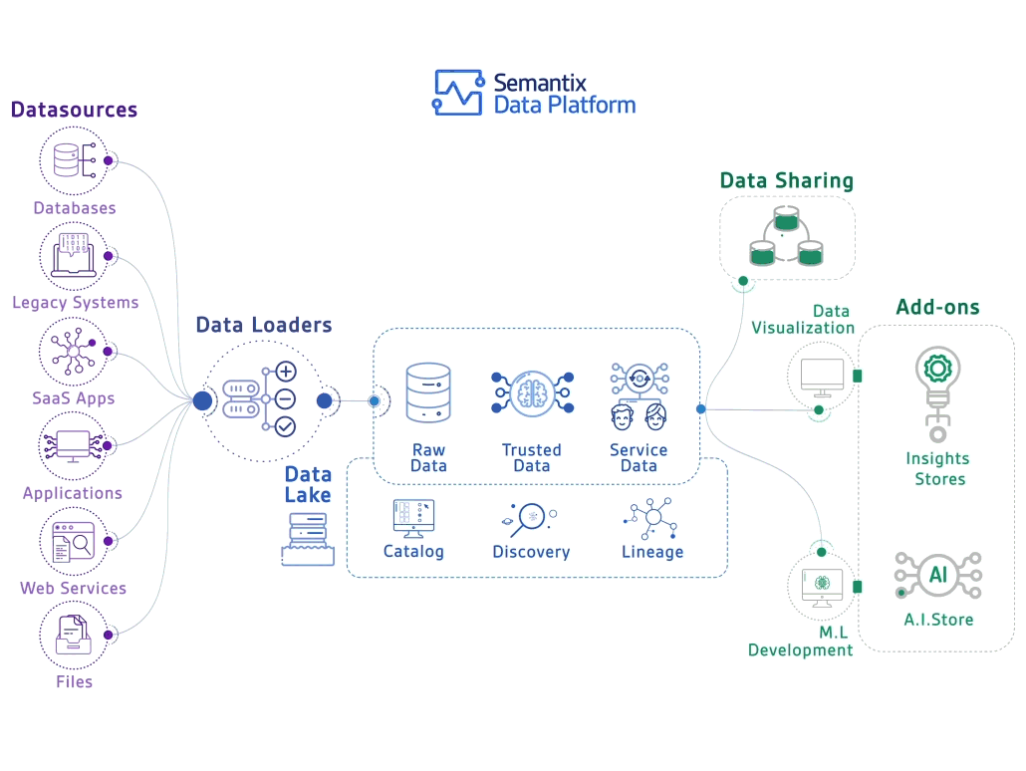

Slide 6





LOB
CRM
BI + Reporting
INGEST
STORE
PREP
MODEL & SERVE
(& store)
Graph
Advanced Analytics
Image
Social
Data orchestration and monitoring
Big data store
Transform & Clean
Data warehouse
AI
IoT
Azure Data Factory
SSIS
Azure Data Lake Storage Gen2
Blob Storage
Azure Data Lake Storage Gen1
SQL Server 2019 Big Data Cluster
Azure Databricks
Azure HDInsight
PolyBase & Stored Procedures
Power BI Dataflow
Azure SQL Data Warehouse
Azure Analysis Services
SQL Database (Single, MI, HyperScale, Serverless)
SQL Server in a VM
Azure Data Lake Analytics Cosmos DB
Power BI Aggregations

Slide 7

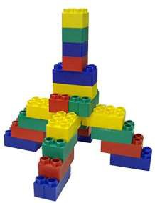


Slide 8







Slide 9


Slide 10


Slide 11
Questions to ask customer
Can you use the cloud?
Is this a new solution or a migration?
What is the skillset of the developers?
Will you use non-relational data (variety)?
How much data do you need to store (volume)?
Is this an OLTP or OLAP/DW solution?
Will you have streaming data (velocity)?
Will you use dashboards and/or ad-hoc queries?
Will you use batch and/or interactive queries?
How fast do the operational reports need to run?
Will you do predictive analytics?
Do you want to use Microsoft tools or open source?
What are your high availability and/or disaster recovery requirements?
Do you need to master the data (MDM)?
Are there any security limitations with storing data in the cloud?
Does this solution require 24/7 client access?
How many concurrent users will be accessing the solution at peak-time and on average?
What is the skill level of the end users?
What is your budget and timeline?
Is the source data cloud-born and/or on-prem born?
How much daily data needs to be imported into the solution?
What are your current pain points or obstacles (performance, scale, storage, concurrency, query times, etc)?
Are you ok with using products that are in preview?

Slide 12


Slide 13
LOB
CRM
BI + Reporting
INGEST
STORE
PREP
MODEL & SERVE
(& store)
Graph
Advanced Analytics
Image
Social
Data orchestration and monitoring
Big data store
Transform & Clean
Data warehouse
AI
IoT
Azure Data Factory
SSIS
Azure Data Lake Storage Gen2
Blob Storage
Azure Data Lake Storage Gen1
SQL Server 2019 Big Data Cluster
Azure Databricks
Azure HDInsight
PolyBase & Stored Procedures
Power BI Dataflow
Azure SQL Data Warehouse
Azure Analysis Services
SQL Database (Single, MI, HyperScale, Serverless)
SQL Server in a VM
Azure Data Lake Analytics Cosmos DB
Power BI Aggregations

Slide 14













Slide 15










Slide 16



Slide 17
LOB
CRM
INGEST
Data orchestration and monitoring
STORE Big data store | PREP Transform & Clean | MODEL & SERVE (& store) Data warehouse
Azure Data Lake Storage Gen2 Blob Storage Azure Data Lake Storage Gen1 SQL Server 2019 Big Data Cluster
BI + Reporting
Graph
Advanced Analytics
Image
Social
AI
IoT
Azure Data Factory
SSIS
Azure Databricks
Azure HDInsight
PolyBase & Stored Procedures
Power BI Dataflow
Azure SQL Data Warehouse
Azure Analysis Services
SQL Database (Single, MI, HyperScale, Serverless)
SQL Server in a VM
Azure Data Lake Analytics Cosmos DB
Power BI Aggregations

Slide 18









Slide 19



non-analytical use cases that only need object storage rather than hierarchical storage

Slide 20
Zone 1
Zone 2
Zone 3
LRS
Multiple replicas across a datacenter
Protect against disk, node, rack failures
Write is ack’d when all replicas are committed
Superior to dual-parity RAID
11 9s of durability
SLA: 99.9%
ZRS
GRS
RA-GRS
Replicas across 3 Zones
Protect against disk, node, rack and zone failures
Synchronous writes to all 3 zones
12 9s of durability Available in 8 regions SLA: 99.9%
Multiple replicas across each of 2 regions
Protects against major regional disasters
Asynchronous to secondary 16 9s of durability
SLA: 99.9%
GRS + Read access to secondary Separate secondary endpoint
RPO delay to secondary can be queried
SLA: 99.99% (read), 99.9% (write)

Slide 21


Slide 22







updateable distributed tables and replicated dimensional tables). We now have HDFS on-prem version. Both SQL and Spark can access same data. Great if you are already a SQL shop

Slide 23


Slide 24
LOB
CRM
BI + Reporting
INGEST
STORE
PREP
MODEL & SERVE
(& store)
Graph
Advanced Analytics
Image
Social
Data orchestration and monitoring
Big data store
Transform & Clean
Data warehouse
AI
IoT
Azure Data Factory
SSIS
Azure Data Lake Storage Gen2
Blob Storage
Azure Data Lake Storage Gen1
SQL Server 2019 Big Data Cluster
Azure Databricks
Azure HDInsight
PolyBase & Stored Procedures
Power BI Dataflow
Azure Data Lake Analytics
Azure SQL Data Warehouse
Azure Analysis Services
SQL Database (Single, MI, HyperScale, Serverless)
SQL Server in a VM Cosmos DB
Power BI Aggregations

Slide 25






















Slide 26

Databricks is the preferred product over HDI, unless the customer has a mature Hadoop ecosystem already established, wants to be 100% open source, wants to use other Hadoop tools that are available 24/7 at a lower cost, or wants to use other tools like Kafka/Storm/HBase/R Server/LLAP/Hive/Pig
always running and incurring costs (no pausing or auto scale). Hortonworks merged with Cloudera

Slide 27





Stick with T-SQL and don’t want to deal with Spark or Hive or other more-difficult technologies

Slide 28





Integrates data lake and data prep technology (Power Query) directly into Power BI Service, independent of PBI reports. Self-service data prep
Individual solution or for small workloads. Data Analysts and Business Analysts. Can transform data that lands in the data lake and can then be used as part of an enterprise solution

Slide 29



transforming large amounts of data in a data lake or replacing long-running monthly batch processing with shorter running distributed processes. Predictable performance with no startup time
Does not support interactive
queries, persistence, or indexing

Slide 30



Slide 31
LOB
CRM
BI + Reporting
INGEST
STORE
PREP
MODEL & SERVE
(& store)
Graph
Advanced Analytics
Image
Social
Data orchestration and monitoring
Big data store
Transform & Clean
Data warehouse
AI
IoT
Azure Data Factory
SSIS
Azure Data Lake Storage Gen2
Blob Storage
Azure Data Lake Storage Gen1
SQL Server 2019 Big Data Cluster
Azure Databricks
Azure HDInsight
PolyBase & Stored Procedures
Power BI Dataflow
Azure Data Lake Analytics
Azure SQL Data Warehouse
Azure Analysis Services
SQL Database (Single, MI, HyperScale, Serverless)
SQL Server in a VM Cosmos DB
Power BI Aggregations

Slide 32













SQL-based, fully-managed, petabyte-scale cloud data warehouse.
Can scale compute and storage independently allowing you to burst compute, and c
MPP technology that shines when used for ad-hoc queries and operational reports in relational format
equires data to be copied from ADLS into SQL DW but this can be done quickly using PolyBase

Slide 33



slower performance for ad-hoc queries
Area a

Slide 34













Slide 35




cases: Need control over / access to the operating system, have to run the app or agents side-by-side with the DB, need to use older version of SQL Server, SSRS, DW in the 4TB-50TB range, 3rd-party app not certified for PaaS, DBA afraid of losing his job, control over backups and maintenance window, want to avoid risk
How to use: IaaS. Provision

Slide 36






A globally distributed, multi-model (key-value, graph, and document) database service. It fits into the NoSQL camp by having a non- relational model (supporting schema-on-read and JSON documents)
Works really well for large-scale OLTP solutions.
for DW aggregations. Use for data lake to have one datastore for both operational and analytical queries

Slide 37



Slide 38






Slide 39


Artificial Intelligence Decision Tree Big Data Decision Tree v4
Business Intelligence Solutions Decision Tree

Slide 40


Slide 41


Slide 42
Microsoft data platform solutions
Product | Category | Description | More Info
SQL Server 2017 | RDBMS | Earned top spot in Gartner’s Operational Database magic quadrant. JSON support. Linux support | https://www.microsoft.com/en-us/server- cloud/products/sql-server-2017/
SQL Database | RDBMS/DBaaS | Cloud-based service that is provisioned and scaled quickly. Has built-in high availability and disaster recovery. JSON support. Managed Instance option | https://azure.microsoft.com/en- us/services/sql-database/
SQL Data Warehouse | MPP RDBMS/DBaaS | Cloud-based service that handles relational big data. Provision and scale quickly. Can pause service to reduce cost | https://azure.microsoft.com/en- us/services/sql-data-warehouse/
Azure Data Lake Store | Hadoop storage | Removes the complexities of ingesting and storing all of your data while making it faster to get up and running with batch, streaming, and interactive analytics | https://azure.microsoft.com/en- us/services/data-lake-store/
HDInsight | PaaS Hadoop compute/Hadoop clusters-as-a-service | A managed Apache Hadoop, Spark, R Server, HBase, Kafka, Interactive Query (Hive LLAP) and Storm cloud service made easy | https://azure.microsoft.com/en- us/services/hdinsight/
Azure Databricks | PaaS Spark clusters | A fast, easy, and collaborative Apache Spark based analytics platform optimized for Azure | https://databricks.com/azure
Azure Data Lake Analytics | On-demand analytics job service/Big Data-as-a- service | Cloud-based service that dynamically provisions resources so you can run queries on exabytes of data. Includes U- SQL, a new big data query language | https://azure.microsoft.com/en- us/services/data-lake-analytics/
Azure Cosmos DB | PaaS NoSQL: Key-value, Column-family, Document, Graph | Globally distributed, massively scalable, multi-model, multi- API, low latency data service – which can be used as an operational database or a hot data lake | https://azure.microsoft.com/en- us/services/cosmos-db/
Azure Database for PostgreSQL, MySQL, and MariaDB | RDBMS/DBaaS | A fully managed database service for app developers | https://azure.microsoft.com/en- us/services/postgresql

Slide 43





A z u r e D a t a L a k e S t o r a g e G e n 2
A “no-compromises” Data Lake: secure, performant, massively-scalable Data Lake storage that brings the cost and scale profile of object storage together with the performance and analytics feature set of data lake storage
S E C U R E
M A N A G E A B L E
F A S T
S C A L A B L E
C O S T
E F F E C T I V E
I N T E G R A T I O N R E A D Y
Support for fine- grained ACLs, protecting data at the file and folder level
Multi-layered protection via at-rest Storage Service encryption and Azure Active Directory integration
Automated Lifecycle Policy Management
Atomic file operations means jobs complete faster
No limits on data store size
Object store pricing levels
Optimized for Spark and Hadoop Analytic Engines
Global footprint (50 regions)
File system operations minimize transactions required for job completion
Object Level
tiering
Tightly integrated with Azure end to end analytics solutions

Slide 44
Integrating all data
Managing all data
Managed data lake with SQL Server and Spark
AI over all data
Complete AI platform
Data virtualization
Analytics
Apps
Admin portal and management services Integrated AD-based security
T-SQL
REST API containers for models
SQL Server External Tables
SQL
Server
Spark
SQL Server ML Services
Spark & Spark ML
Compute pools and data pools
Scalable, shared storage (HDFS)
Open database connectivity
NoSQL
Relational databases
HDFS
External data sources
HDFS
Combine data from many sources without moving or replicating it
Scale out compute and caching to boost performance
Store high volume data in a data lake and access it easily using either SQL or Spark
Management services, admin portal, and integrated security make it all easy to manage
Easily feed integrated data from many sources to your model training
Ingest and prep data and then train, store, and operationalize your models all in one system
Intelligence over all data

Slide 45



Increase analytics and apps performance
Custom apps
BI
Analytics
SQL
SQL Server master instance
Compute pool
Compute pool
Compute pool
Directly read from HDFS
SQL Compute Node
SQL Compute Node
SQL Compute Node
SQL Compute Node
…
SQL Compute Node
Data pool
Storage pool
SQL Data Node
Storage
SQL Data Node
Storage
Spark
SQL
Server
Spark |  |  | SQL Server
HDFS Data Node
Spark |  |  | SQL Server
HDFS Data Node
…
HDFS Data Node
IoT data
Kubernetes pod
Node Node Node Node Node
Node Node
Persistent storage
Intelligence over all data

Slide 46







Slide 47



Programming Model | General Purpose | Business Critical | Hyperscale | Elastic Pools
Instance (MI) | GA, 8TB | GA, 4TB | Private Preview, 100TB | April private preview
Database (Single) | GA, 4TB [Serverless] | GA, 4TB | Public Preview, 100TB | GA

Slide 48



















Power BI Self-service data prep Dataflows AI consumption Enterprise BI Semantic models Self-service BI | Azure Data Factory Data ingestion & orchestration | Azure Databricks Enterprise data prep | Azure SQL DW Curated data
Contact Lead Opportunity Account Customer Profile Product Profile People Profile

Slide 50



C L O U D
D A T A
W A R E H O U S E
INGEST
STORE
PREP & TRAIN
MODEL & SERVE
Logs (unstructured)
Media (unstructured)
PolyBase
Files (unstructured)
Azure Data Factory
Azure Data Lake Store Gen2
Azure SQL Data Warehouse
Azure Analysis Services
Power BI
Business/custom apps
(structured)
Microsoft Azure also supports other Big Data services like Azure HDInsight to allow customers to tailor the above architecture to meet their unique needs.

Slide 51
M O D E R N
D A T A
W A R E H O U S E
INGEST
STORE
PREP & TRAIN
MODEL & SERVE
Logs (unstructured)
Azure Databricks
Media (unstructured)
PolyBase
Files (unstructured)
Azure Data Factory
Azure Data Lake Store Gen2
Azure SQL Data Warehouse
Azure Analysis Services
Power BI
Business/custom apps
(structured)
Microsoft Azure also supports other Big Data services like Azure HDInsight to allow customers to tailor the above architecture to meet their unique needs.

Slide 52



A D V A N C E D A N A L Y T I C S O N B I G D A T A
INGEST
STORE
PREP & TRAIN
MODEL & SERVE
Logs (unstructured)
Azure Databricks
SparkR
Cosmos DB
Real-time apps
Media (unstructured)
PolyBase
Files (unstructured)
Azure Data Factory
Azure Data Lake Store Gen2
Azure SQL Data Warehouse
Azure Analysis Services
Power BI
Business/custom apps
(structured)
Microsoft Azure also supports other Big Data services like Azure HDInsight, Azure Machine Learning to allow customers to tailor the above architecture to meet their unique needs.

Slide 53




R E A L
T I M E
A N A L Y T I C S
INGEST
STORE
PREP & TRAIN
MODEL & SERVE
Sensors and IoT (unstructured)
Azure Databricks
Logs (unstructured)
Apache Kafka for HDInsight
Cosmos DB
Real-time apps
Media (unstructured)
Files (unstructured)
PolyBase
Business/custom apps (structured)
Azure Data Factory
Azure Data Lake Store Gen2
Azure SQL Data Warehouse
Azure Analysis Services
Power BI
Microsoft Azure also supports other Big Data services like Azure IoT Hub, Azure Event Hubs, Azure Machine Learning to allow customers to
tailor the above architecture to meet their unique needs.

Slide 54
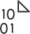




D A T A
M A R T
C O N S O L I D A T I O N
INGEST
STORE
MODEL & SERVE
PolyBase
RDBMS data marts
Azure Data Factory
Azure Data Lake Store Gen2
Azure SQL Data Warehouse
Azure Analysis Services
Power BI
Hadoop
Microsoft Azure also supports other Big Data services like Azure HDInsight to allow customers to tailor the architecture to meet their unique needs.

Slide 55



H U B & S P O K E A R C H I T E C T U R E F O R B I
INGEST
STORE
PREP & TRAIN
MODEL & SERVE
Data Marts
SQL
Multiple Azure SQL Database instances
Business/custom apps (structured)
Azure Databricks
Logs (unstructured)
PolyBase
Azure Data Factory
Azure Data Lake Store Gen2
Azure SQL Data Warehouse
Power BI
Media (unstructured)
Data Cubes
Multiple Azure Analysis Services instances
Files (unstructured)
Microsoft Azure supports other services like Azure HDInsight to allow customers a truly customized solution.

Slide 56
A U T O
S C A L I N G
D A T A
W A R E H O U S E
INGEST
STORE
PREP & TRAIN
MODEL & SERVE
Business/custom apps (structured)
Azure Databricks
Logs (unstructured)
PolyBase
Azure Data Factory
Azure Data Lake Store Gen2
Azure SQL Data Warehouse
Azure Analysis Services
Power BI
Media (unstructured)
Azure Functions (Auto-scaling)
Files (unstructured)
Microsoft Azure supports other services like Azure HDInsight to allow customers a truly customized solution.

Slide 57



D A T A
W A R E H O U S E
M I G R A T I O N
INGEST
STORE
PREP & TRAIN
MODEL & SERVE
Business/custom apps (structured)
PolyBase
Azure SQL Data Warehouse
Business/custom apps
Logs (unstructured)
Azure Analysis Services
Media (unstructured)
Azure Data Factory
Azure Data Lake Store Gen2
Azure Databricks
Power BI
Files (unstructured)
Azure also supports other Big Data services like Azure HDInsight to allow customers to tailor the architecture to meet their unique needs.

Slide 58
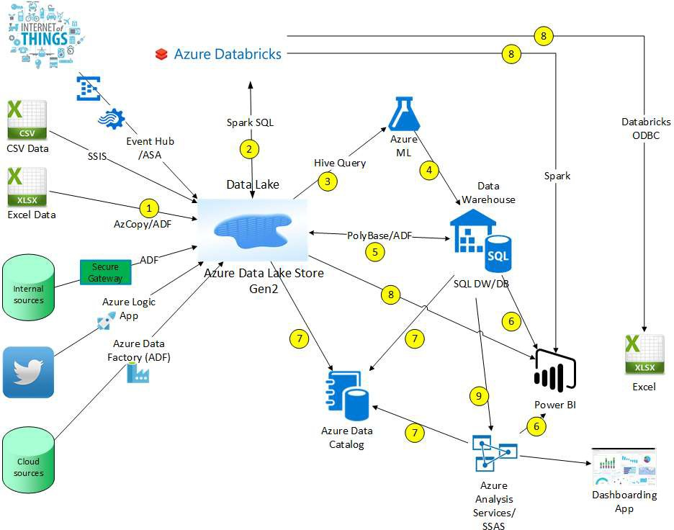

Slide 59








